Slide 1
Web scraping

Slide 2
In this lecture, we'll discuss webscraping
First isntall requests and beautifulsoup4 and selenium
Let's take an example by trying to grab and plot the table of multiple Olympic medalists from Wikipedia then create a barplot of which sports have the most multiple medal winners

Slide 3
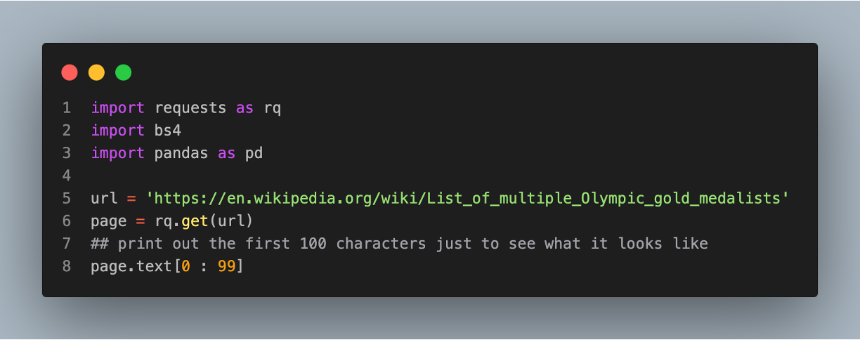
Reading in the data
'<!DOCTYPE html>\n<html class="client-nojs vector-feature-language-in-header-enabled vector-feature-l'

Slide 4
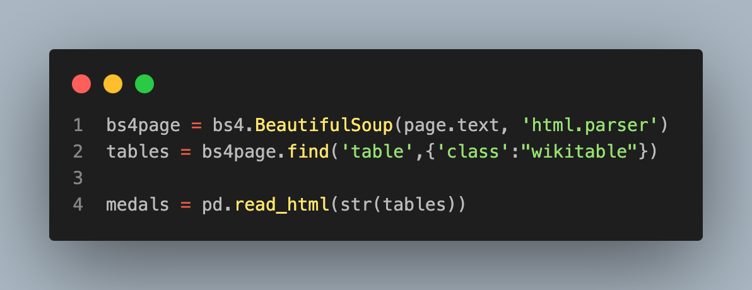
Reading into BS4
We add the class and wikitable information to specify which tables that we want.
If you want to find classes, you can use a web tool, like selector gadget or viewing the page source.

Slide 5
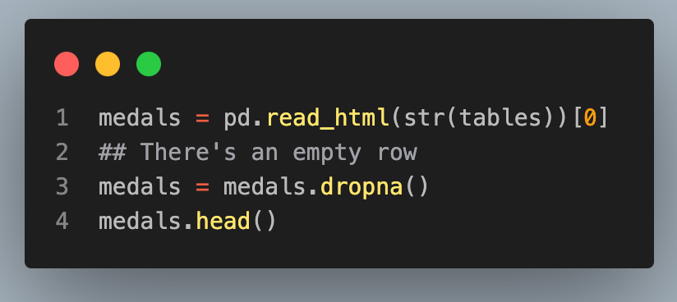
Reading into pandas
Now we should take the html that we've saved, then read it into pandas.
Fortunately, pandas has a read_html method.
 | No. | Athlete | Nation | Sport | Years | Games | Gender | Gold | Silver | Bronze | Total
0 | 1 | Michael Phelps | United States | Swimming | 2000–2016 | Summer | M | 23.0 | 3.0 | 2.0 | 28.0
1 | 2 | Larisa Latynina | Soviet Union | Gymnastics | 1956–1964 | Summer | F | 9.0 | 5.0 | 4.0 | 18.0
2 | 3 | Paavo Nurmi | Finland | Athletics | 1920–1928 | Summer | M | 9.0 | 3.0 | 0.0 | 12.0
3 | 4 | Mark Spitz | United States | Swimming | 1968–1972 | Summer | M | 9.0 | 1.0 | 1.0 | 11.0
4 | 5 | Carl Lewis | United States | Athletics | 1984–1996 | Summer | M | 9.0 | 1.0 | 0.0 | 10.0

Slide 6
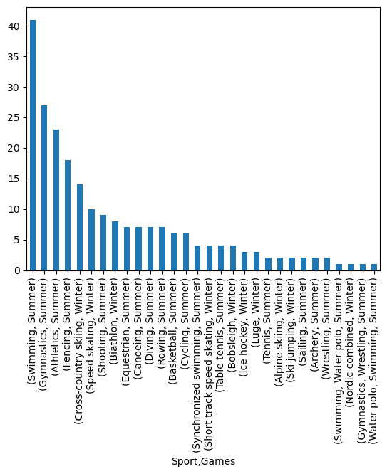
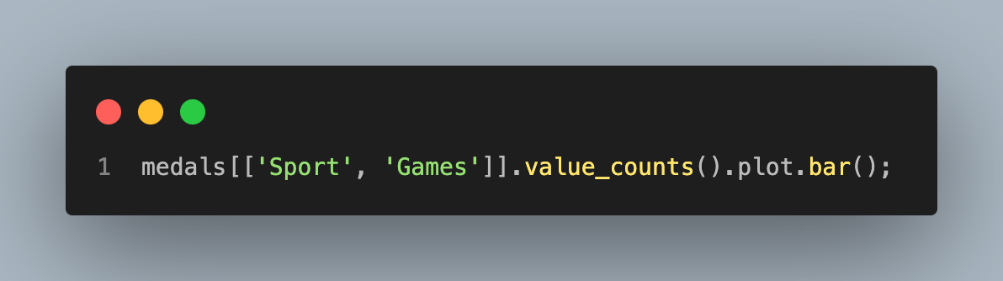
Creating a plot

